Slide 1

Comment Anywhere
The browser extension for commenting the Internet.
Created by Karl Miller, Luke Bates, and Frank Bedekovich

Slide 2
Project Overview

Slide 3
What is Comment Anywhere?
Comment Anywhere is a web service that allows users to access a unique comment section for any webpage on the Internet.
Comment Anywhere runs as a browser extension for Mozilla Firefox.
When a user clicks the "Comment Anywhere Guy" icon, a drop-down interface appears that lets them see and post comments for the webpage they are currently viewing.

Slide 4
Agenda
In this presentation, we will discuss:
Comment Anywhere's User Interface, and the important features it provides.
Our motivation for creating Comment Anywhere.
The issue of moderation.
How Comment Anywhere communicates with the server.
How the server is structured.
Browser Extension Technology.
A brief demo video.
Code metrics.

Slide 5
Comment Anywhere: A Quick Look

Slide 6
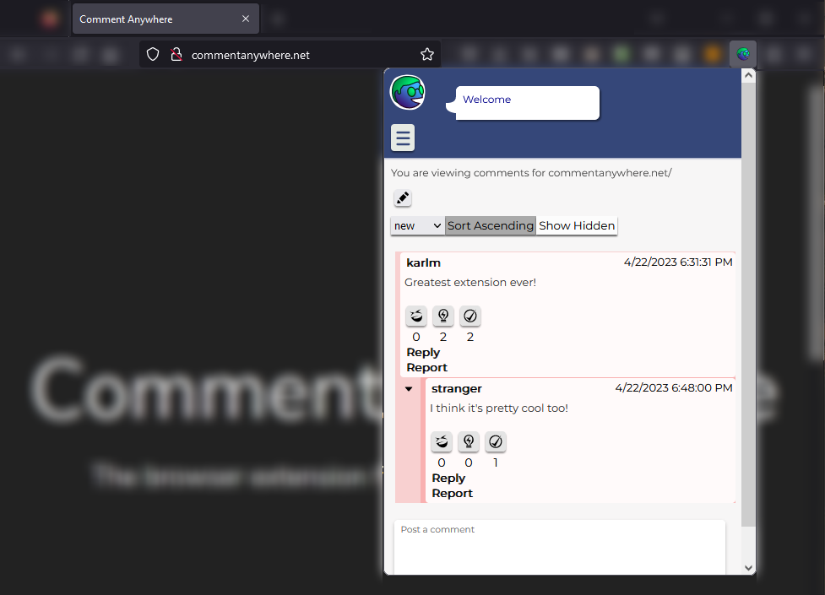
The Comment Anywhere Guy provides helpful messages from the server
Users can sort comments by any of these dimensions.
There are three dimensions for rating comments: funny, factual, and agree.

Slide 7
Each comment section is unique to the URL they are viewing.
Moderated comments can be removed or hidden.
Users may opt-in to view hidden comments, which may contain possibly objectionable content.
Users can reply to comments, report comments, and post new top-level comments.

Slide 8
Motivation
Comment Sections on websites were once ubiquitous; now, many have closed. [1]
Conversations have moved to social media posts. (Facebook, Twitter, Reddit)
Social media posts as comment sources fundamentally fragment the conversation.
Conversation (and valuable comment information) becomes split between many posts.
While it is usually easy to go from a comment section on social media to the content, it is very hard to go from the content to the many posts on social media.
There should exist comment sections that are closely coupled to the content.
These comment sections should follow the content wherever it is shared, on any platform.
Persistent, coupled comments make it more difficult for agendas to silence disempowered voices.
It also makes the useful information often found in comment sections more freely available to all.
[1] Techdirt – Killing comment sections

Slide 9
Issue: Moderation
Moderation is an issue all comment providers must contend with.
Too little moderation? You risk a toxic environment and legal consequences.
Too much moderation? You may alienate users.
To combat this issue, we introduced a special access user called a Domain Moderator. These users can only moderate comments on their assigned domain. They may also ban users on said domain.
Therefore, we can apply more restrictive comment policies (when necessary) to certain webpages and portion out the authority we delegate.
Additionally, all moderation actions are recorded in our database and can be reviewed for abuses.
We did not write a Terms of Service or Content Policy, but our general notion is that comments should be less moderated on pages of public interest (e.g., government and news sites) and more moderated for sites belonging to private individuals and small businesses.
Before the full launch we will need legal consultation, an understanding of target market, and a solid business plan to inform our moderation policy.
Comment moderation is a difficult and nuanced issue. We have not solved it, but we programmed some tools to approach it.

Slide 10
Implementation

Slide 11
Docker
"Docker provides the ability to package and run an application in a loosely isolated environment called a container. The isolation and security allows you to run many containers simultaneously on a given host. Containers are lightweight and contain everything needed to run the application". [2]
Comment Anywhere utilizes 3 docker containers. They each listen on a specific port for information.
The Postgres database. (Listens on port 5432)
The HTTP server. (Listens on port 3000)
The Comment Anywhere static website. (Listens on port 80)

Slide 12
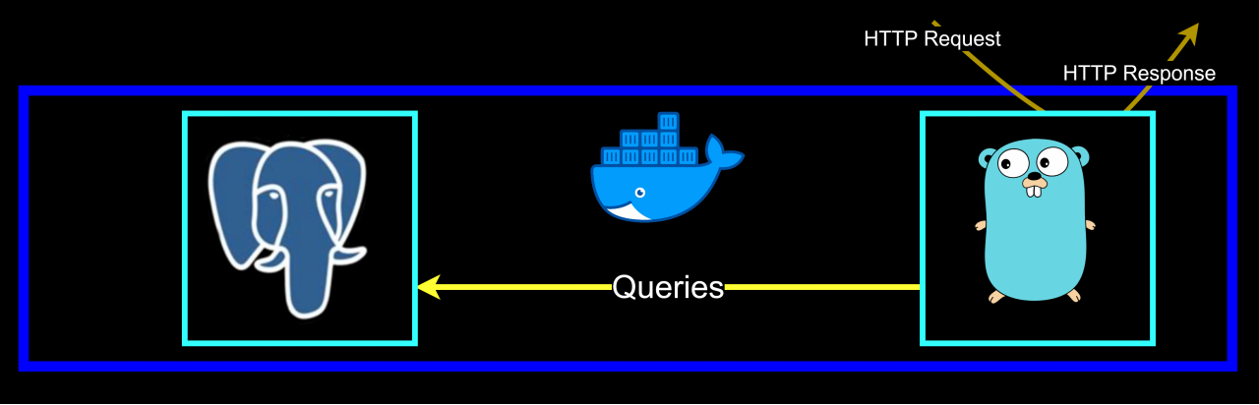
Two Core Back End System Processes
The back end operates on two core system processes.
The Postgres Database
The Go HTTP Server
Both run in Docker containers.

Slide 13
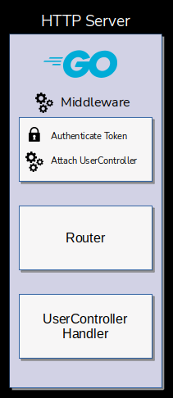
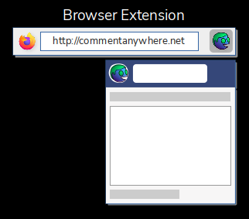
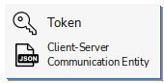
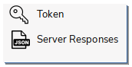
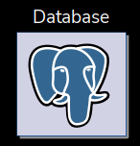
Client-Server Communication
Middleware authenticates the token and attaches the appropriate controller for the access level
The client parses the response and renders it on the user interface
Hello!
The router determines the endpoint handler which parses the body into the communication type
The request is dispatched to the server
Useful and interesting data
The endpoint handler calls the relevant method on the controller, passing the communication type
The client generates an HTTP Request
The response is dispatched to the client
The controller handler queries the database
It builds a response from transformed data

Slide 14



Browser Extension
Rendering the browser extension is like rendering a webpage. It uses:
Hypertext Markup Language (HTML) to define the structure of UI elements.
Cascading Style Sheets (CSS) to stylize the elements.
TypeScript (compiles to JavaScript) to add functionality to those elements.
We use Mozilla's Browser API to access additional features, such as persistent storage.
We do not use any front-end frameworks (e.g., Angular, React) for rendering UI.

Slide 15
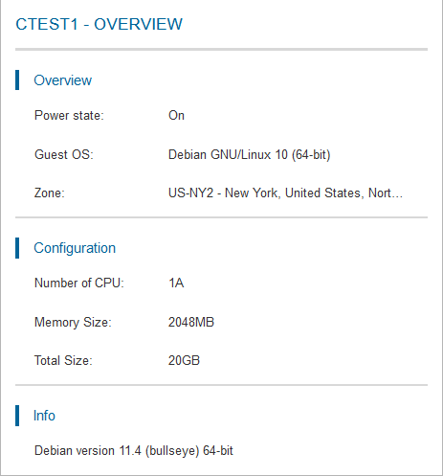
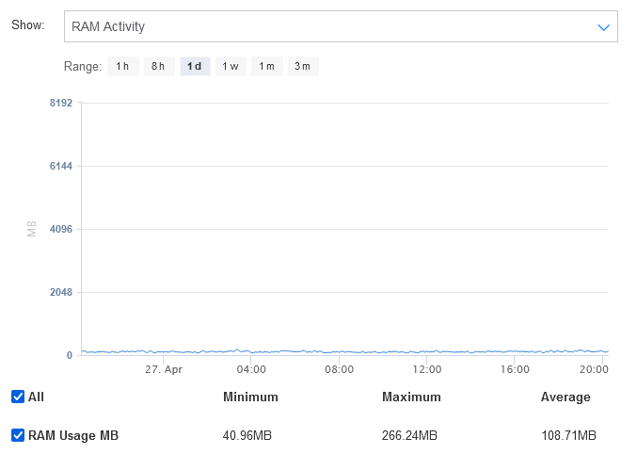
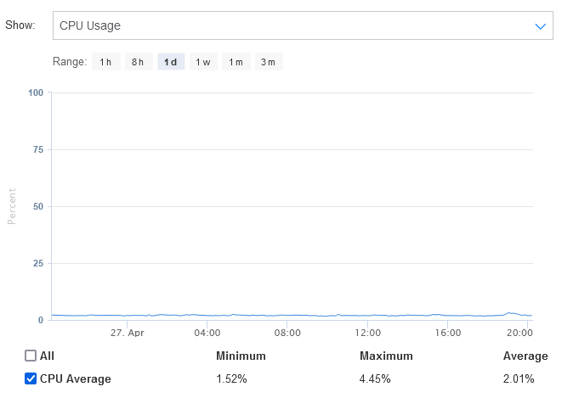
Deployment: Back End
We purchased a Virtual Private Server allocation from Kamatera.
We purchased a domain from Domain.com.
We chose a minimal and inexpensive allocation.
Our server has minimum background resource consumption.
CPU usage averages 2.01%
RAM usage averages 108.71 MB.

Slide 16
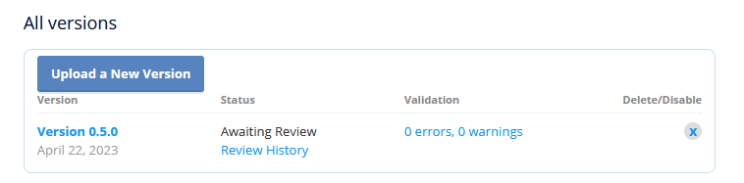
Deployment: Front End
Our landing page is visible at http://commentanywhere.net.
This site hosts the download link for the alpha version of our browser extension
We submitted our extension on Mozilla’s developer portal.
When it finishes review, it will be added to the official “Addons for Firefox” collection.
We will be able to set up an update pipeline for updates.

Slide 17
Demo Video

Slide 18
Code Metrics: Front End Cloc

Slide 19
Code Metrics: Back End Cloc

Slide 20
Contributions
Karl proposed the idea, designed the architecture, and implemented the HTTP Server and Database. He deployed the server to the cloud. He also contributed much of the Front End code.
Luke coded much of the Front End and improved the Front End architecture. He added several ideas to the design, including multiple vote dimensions. He designed all the graphics and logos and was responsible for Comment Anywhere’s elegant look and feel.
Frank assisted with parts of the Front End, including prototyping the moderation panel, and performed research on Docker.

Slide 21
References
[1] https://www.techdirt.com/2021/11/08/killing-website-comment-sections-wasnt-brilliant- move-many-newsroom-leaders-assumed/
[2] https://docs.docker.com/get-started/overview/

Slide 22
Supplemental Slides: Detailed Implementation

Slide 23
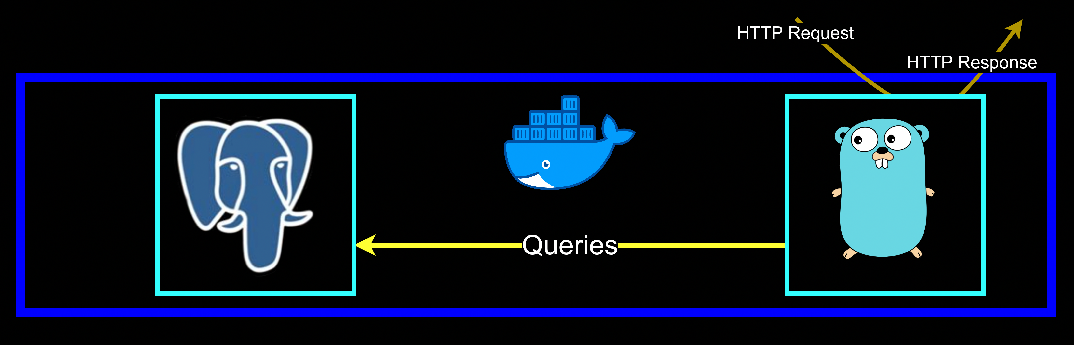
Two Core System Processes
The two core system processes required for the back end to function are:
The Postgres Database
The Go HTTP Server
Both run in Docker containers.

Slide 24
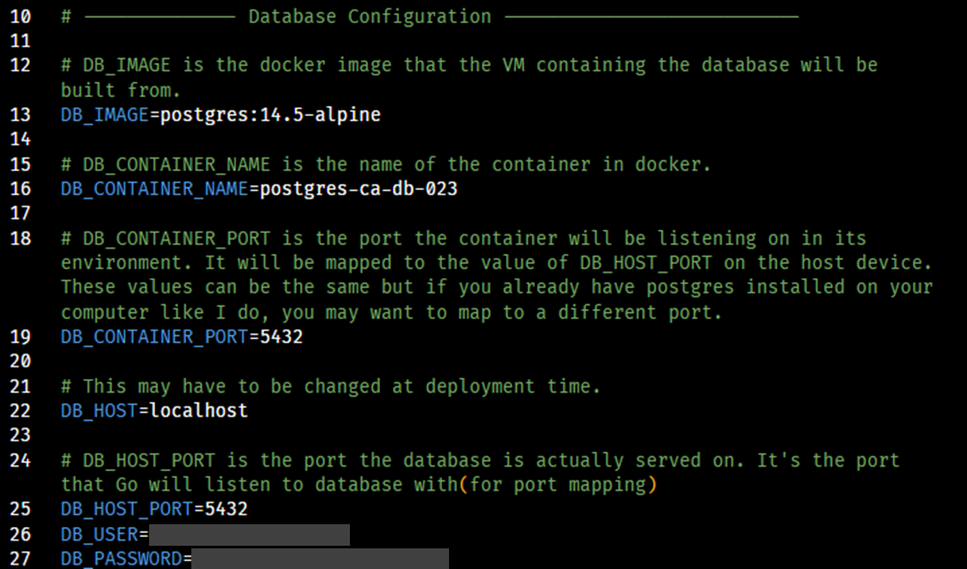
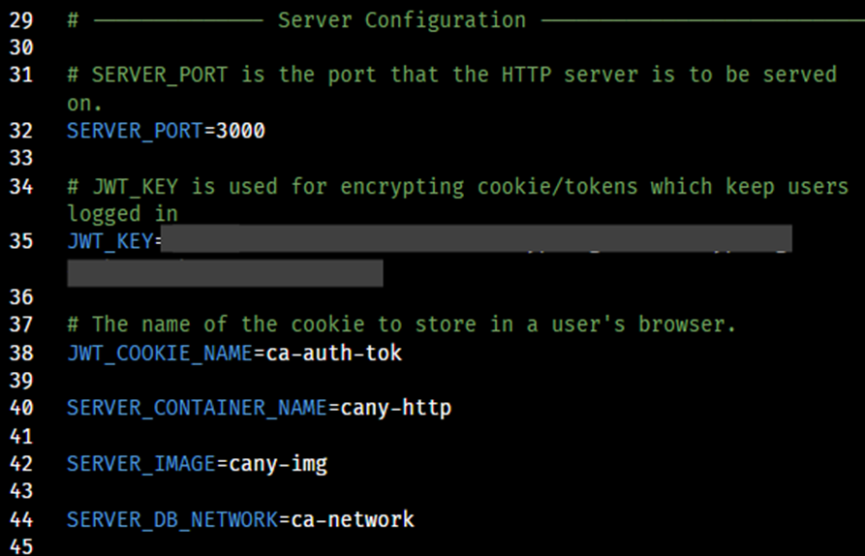
Environment Variables
The two back-end processes easily communicate with few user errors because they both reference the same single set of variables at the time they are initialized, located in a private .env file.

Slide 25
Database System Overview
16 Tables
25 Foreign Key Relations
84 Total Columns
Uses postgres:14.5-alpine docker image as the base.
Used dbdiagram.io to design the initial database; there were ultimately a number of changes.
Uses golang-migrate to systematize applying our schema and changes.
Uses kyleconroy/sqlc to generate Go structs from the schema and queries.

Slide 26
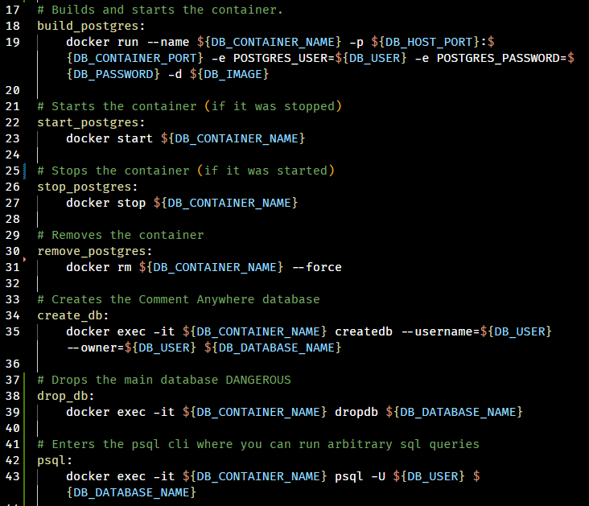
Database: Building
Pictured to the right are snippets from our Makefile.
By importing our .env file to our Makefile, we are able to utilize our environment variables when running command-line executables.
Running make commands this way minimizes user mistakes and repetition.

Slide 27
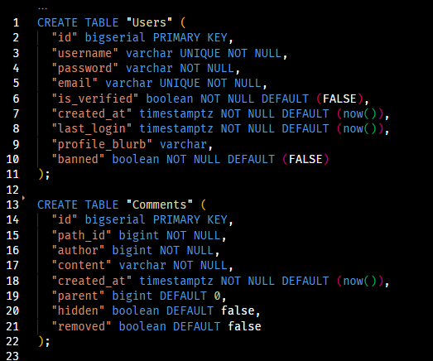
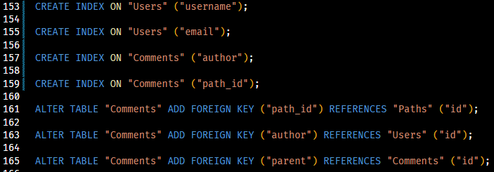
Database: Schema Snippet
Pictured to the right are snippets from our schema SQL file.
The SQL is formatted using Postgres types and conventions.
Indexes are added for frequently used query dimensions.
Foreign keys are added to allow joins and ensure data validity.

Slide 28
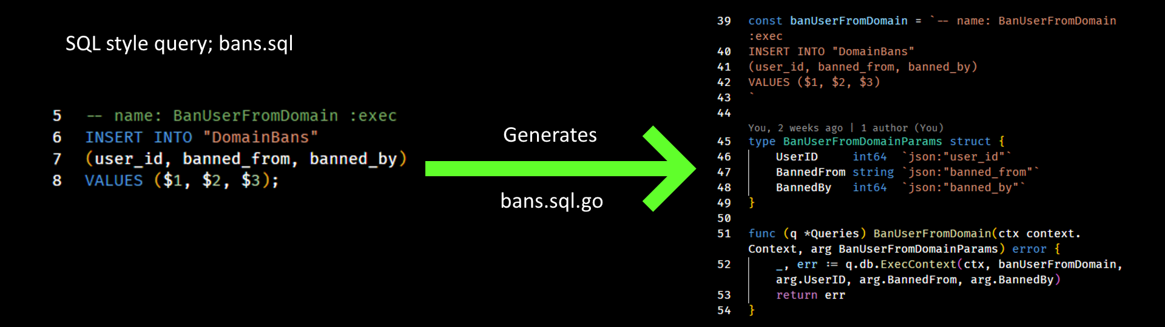
Database: Generating Type-Safe Go Code
Part of the Go Code used on our HTTP Server is automatically generated from the schema of the database and a set of queries.
A program called kyleconroy/sqlc performs the work of transforming that SQL into idiomatic Go, creating types and functions as needed.
67 characters to 498 characters; 750% code multiplier

Slide 29
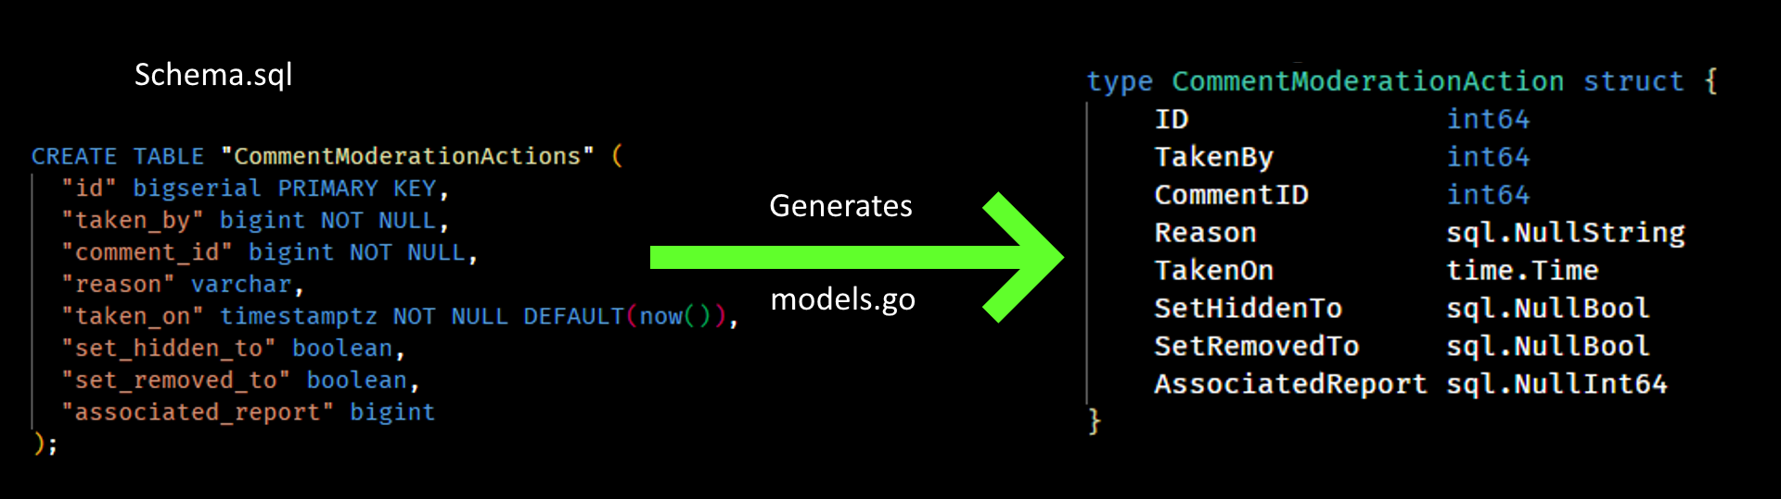
Database: Generating Type-Safe Go Code
A type is also generated for every row-type in the database.
When our schema changes, we can simply re-run sqlc, allowing most changes to be instantly realized in our Go code, minimizing redundancy and the risk of human mistakes.

Slide 30
HTTP Server Code Overview
Coded in Go, primarily for its lightweight threads in order to reduce cloud overhead.
5 modules; server, util, config, communication, and database
server consists of 37 .go files comprising 2,344 lines of non-comment code.
util consists 3 .go files comprising 137 lines of non-comment code.
config contains 1 .go files comprising 382 lines of non-comment code.
communication contains 3 .go files comprising 245 lines of non-comment code.
database contains 14 non-generated and 19 generated source code files comprising 2,600 lines of non-comment code.
There are also 98 lines of Makefile and 11 lines of YAML.
In total, the HTTP Server requires 5,806 lines of code.

Slide 31
HTTP Server Structure Overview
The module server provides the top-level Server object, which provides methods for handling HTTP Request at each endpoint.
The module communication provides types for parsing the JSON data sent from the Front-End and types for building JSON data to respond with.
The module database provides the Store object, whose methods wrap the functions generated by sqlc. Generally, Store executes database queries and converts the results to communication types.
The module config validates and loads the .env file.
The module util provides pure functions for utility purposes, that perform, for example, regular expression input validation and password encryption.

Slide 32
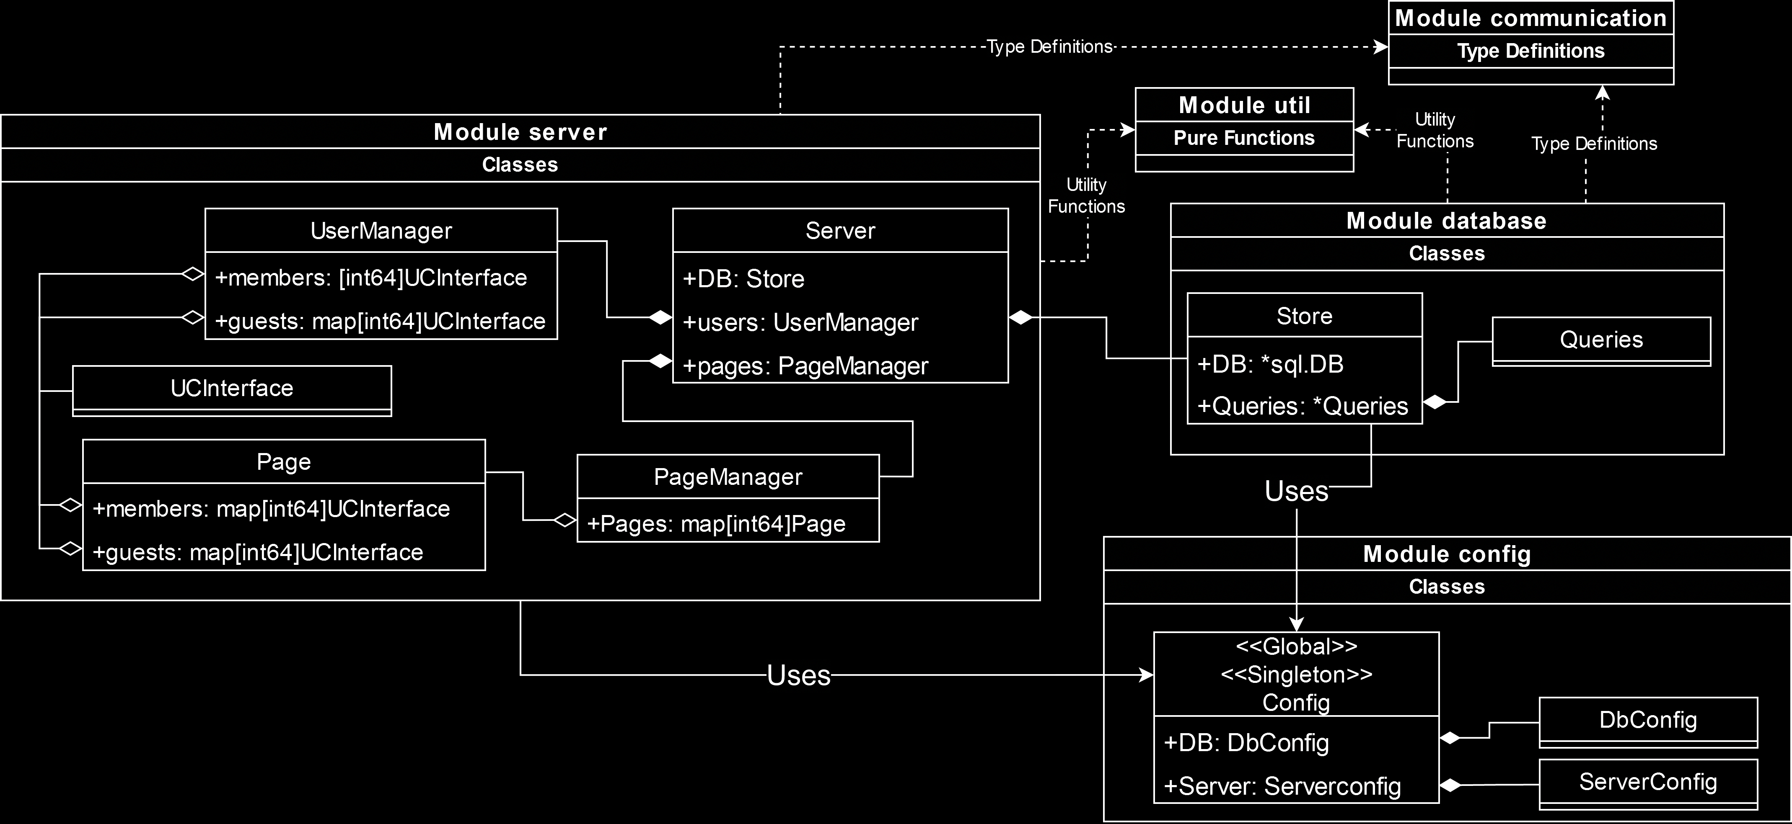
HTTP Server Structure Diagram

Slide 33
HTTP Server Structure Overview
I will describe these modules starting with the simplest and moving to the more complex.
They will be addressed in this order:
config
communication
util
database
server

Slide 34
HTTP Server Structure Diagram

Slide 35
HTTP Server : Module config
The module config is a simple module. It simply looks for the .env file and uses it to load environment variables, then confirms that all the necessary environment variables are loaded. If some required ones are missing, it prints the appropriate error message and fatally crashes the HTTP Server.
The Config object is available to all other modules as a global singleton.
Config.Load is called in main immediately after command line arguments have been parsed to validate the environment variables.
The server cannot run if required, non-defaulting environment variables are not available.

Slide 36
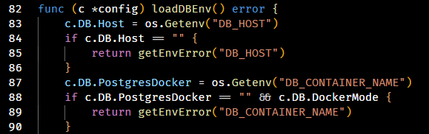
HTTP Server : Module config
The code below is an interesting case. It demonstrates how config requires the environment “DB_CONTAINER_NAME” be present but only if “DockerMode” is true.
DockerMode is set when the executable is run with the flag –docker=true.
This is necessary because Config can produce a database connection string from its environment variables, and this string looks different if the HTTP Server process is running inside a docker container and connecting to the database over a docker network.

Slide 37
HTTP Server Structure Diagram

Slide 38
HTTP Server : Module communication
The module communication provides the types expected by both the HTTP server and front-end client.
For example, the “/register” endpoint expects the body of the HTTP Request to contain a JSON string that can be parsed into a client-to-server communication entity structured as follows:
// Register is dispatched to the server when the client clicks “Submit” on the register form.
type Register struct {
Username string
Password string
RetypePassword string
Email string
AgreedToTerms bool
}

Slide 39
HTTP Server : Module communication
The body of the HTTP Response to a client will ultimately contain a JSON-style string that can be parsed into an array of server-to-client communication entities, which the Front End will process.
For example, the Message entity, often sent when there is a problem with a request, will cause a message to display on the Front End, in either blue or red.
// Message is a general communication entity used to provide feedback to a client that some action has completed (or not completed)
type Message struct {
Success bool
Text string
}

Slide 40
HTTP Server : Module communication
Some messages to the client may be considerably more complex than that. The FullPage and composite server-client communication entities are shown.
// Comment provides the data the Front End needs to render a comment.
type Comment struct {
UserId int64
Username string
CommentId int64
Content string
Factual CommentVoteDimension
Funny CommentVoteDimension
Agree CommentVoteDimension
Hidden bool
Parent int64
Removed bool
TimePosted int64
}
// FullPage is returned when a user first requests comments for a new page. It contains an array of all comment data for that page.
type FullPage struct {
Comments []Comment
Domain string
Path string
}
// CommentVoteDimension contains data for the number of votes on a comment.
type CommentVoteDimension struct {
AlreadyVoted int8
Downs int64
Ups int64
}

Slide 41
HTTP Server Structure Diagram

Slide 42
HTTP Server : Module database
The primary purpose of module database is to wrap calls to the functions generated by sqlc (the code-generation software), abstracting and simplifying the database operations.
These abstractions are implemented as methods of the object database.Store, which is referenced as a top-level member of server.Server.
Store contains a reference to generated.Queries as Store.Queries.
Store methods may make one or more calls to Store.Queries and return either some primitive or transform the data returned by Queries into some communication type(s) and return that.

Slide 43
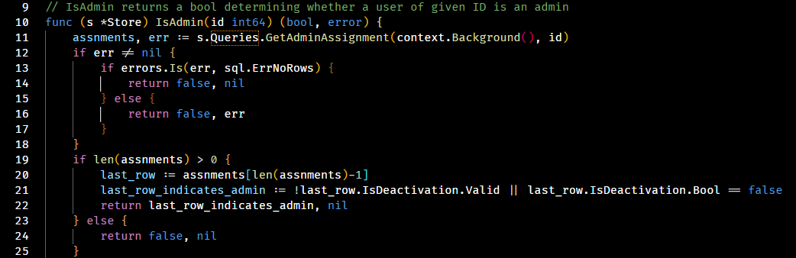
HTTP Server : Module database
For example, when initializing a UserController (described later), we will need to know whether they are an admin. This information is stored in the AdminAssignments table, not in the Users table. Store provides a Boolean-returning method for determining Admin status of a user.

Slide 44
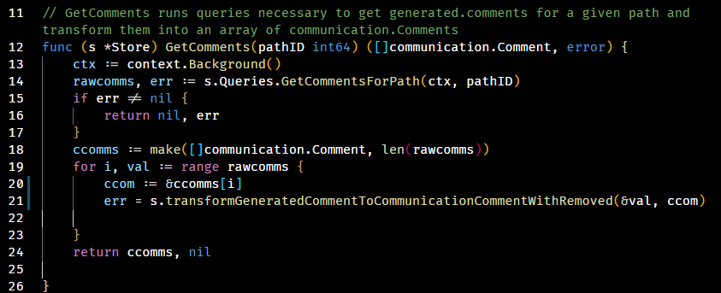
HTTP Server : Module database
Often, Store produces communication entities. In the example, the call to the wordy “transform” function takes raw comment data and builds the final communication entities from it. For example, it hides the content of removed comments and runs an aggregate query to get the vote total.

Slide 45
HTTP Server Structure Diagram

Slide 46
HTTP Server : UserControllerInterface
The entity associated with users as they navigate around server data is UserControllerInterface.
This interface can be a GuestController, MemberController, DomainModeratorController, GlobalModeratorController, or AdminController ; all implement the methods and are used polymorphically.
The UserManager maintains a map of all guest controllers who have recently accessed Comment Anywhere in one map, and all member-or-higher controllers in another.
Each Page, representing a distinct comment section initialized from database data, also keeps a map of controllers that are currently viewing it, so that it can de-initialize when its data is no longer needed.

Slide 47
HTTP Server : UserControllerInterface
TODO: UML DIAGRAM OF INHERITANCE WITH UCI

Slide 48
HTTP Server : UserControllerInterface
A reference to a user’s associated controller is attached to their HTTP Request Context at the time their authentication token is parsed by the middleware. A controller is always attached to a request; if a login token is not existent or invalid, a new GuestController is created for the Request.
The actual calls which realize the effects of a user action, such as posting a comment, are made in their particular controller. The Server object itself is, in general, unconcerned with the access level of a given controller and simply parses the HTTP Request’s body into the appropriate communication type, then hands off the execution of the command to the controller already associated with the request.
Server.PostNewComment may call, for example, HandleNewComment on the interface; if they are a logged in user, a new comment will be posted. If they are a Guest, they will simply receive an error message to display.

Slide 49
HTTP Server : UserControllerInterface
UserControllers have a member array of communication types called nextResponse.
As a request is processed, communication entities, ranging from LoginResponses to Messages to Comment data are pushed to this array.
A request may cause communication entities to be pushed to other UserControllers as well. For example, posting a new comment will cause that new comment data to be pushed to the nextResponse array of all controllers who are currently on that page.
When a request finishes, nextResponse is sent as a JSON array in the body of the HTTP Response.
The front end parses each item of this response and renders changes on the UI accordingly.
Typically, the response items will only be related to the action the user just attempted to perform, but if it has been a while since they talked to the server, there may also be additional items waiting for them.

Slide 50
HTTP Server : Anatomy of a Request’s Life - Preflight
Our server is atypical in that the user is not talking to the server from a webpage we have provided them. They are on some other website or “none” at all in the browser environment.
For this reason, we need to enable a special policy called Cross Origin Resource Sharing (CORS), or modern browsers will interrupt the request.
MDN defines CORS as follows [1]:
“Cross-Origin Resource Sharing (CORS) is an HTTP-header based mechanism that allows a server to indicate any origins (domain, scheme, or port) other than its own from which a browser should permit loading resources. CORS also relies on a mechanism by which browsers make a "preflight" request to the server hosting the cross-origin resource, in order to check that the server will permit the actual request. In that preflight, the browser sends headers that indicate the HTTP method and headers that will be used in the actual request.”

Slide 51
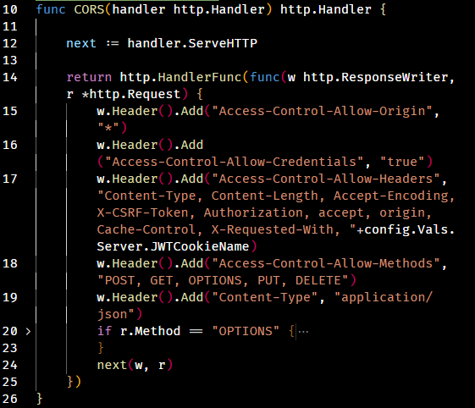
HTTP Server : Anatomy of a Request’s Life - Preflight

Slide 52
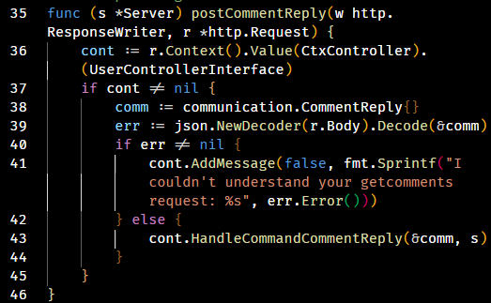
HTTP Server : Anatomy of a Request’s Life - Endpoint

